Slide 1
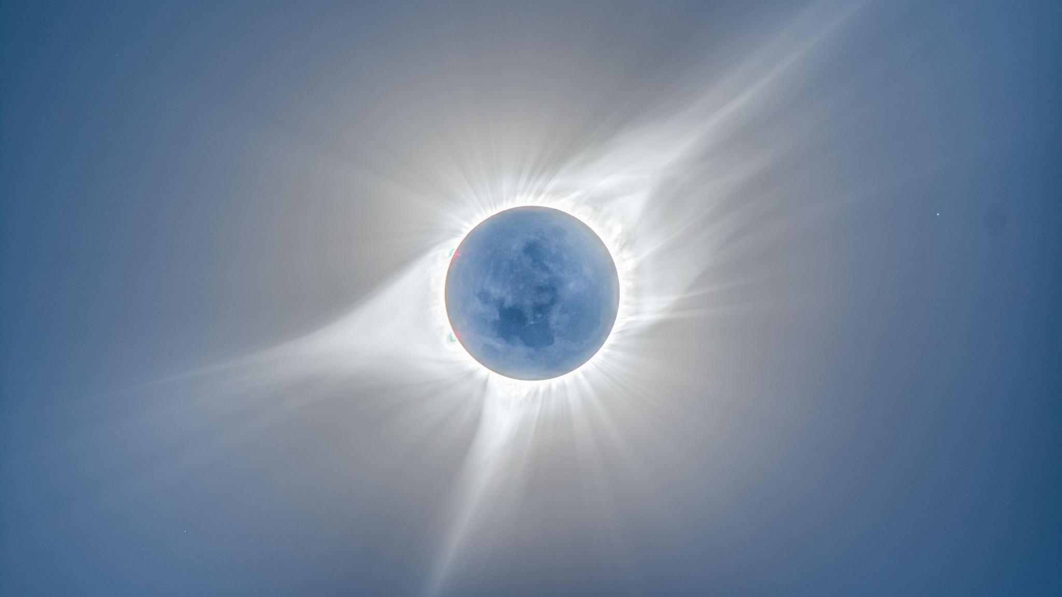
The Birth of Observational Astronomy

Slide 2
Tycho Brahe’s Observatory
Uranibourg., built (ca. 1576) on the island of Hven. The first observatory in the modern sense as an artificial environment to measure phenomena that occur in a pure state of nature. Established new standards of precision in measurement.
Observed a new star that appeared in 1574 and disappeared 18 months later (Tycho’s Star). Brahe believed that this was a new star (hence, supernova), but it was an exploding star. Prevailing opinion regarded this as a local meteorological phenomenon in the atmosphere. Brahe showed that the supernova did not change positions with respect to the other stars. He concluded, on this basis, that it was a real star, not a local phenomenon. This was the first evidence of the mutability of the heavens.
Brahe found that he was unable to measure stellar parallax for this new star or for any of the stars and so rejected Copernicus’ planetary system.

Slide 3

Stellar Parallax
Brahe found that he was unable to measure stellar parallax for this new star or for any of the stars and so rejected Copernicus’ planetary system.
On this basis, he concluded that the Earth is motionless at the center of the Universe OR the stars are so far away that their parallax is too small to measure.
Brahe’s question was insightful, but be refused to believe that the stars could so far away, so he concluded that the Earth was the center of the planetary system and that Copernicus was mistaken.
Brahe proposed a model of the solar system that was intermediate between the Ptolemaic and Copernican models (it had the Earth at the center). It proved to be incorrect, but was the most widely accepted model of the Solar System for a time.

Slide 4
Observation of the Comet of 1577
Brahe made precise observations of a comet in 1577. By measuring the parallax for the comet, he was able to show that the comet was further away than the Moon. This contradicted the teachings of Aristotle, who had held that comets were atmospheric phenomena ("gases burning in the atmosphere" was a common explanation among Aristotelians).
As for the case of the supernova, comets represented an obvious change in a celestial sphere that was supposed to be unchanging; furthermore, it was very difficult to ascribe uniform circular motion to a comet.

Slide 5
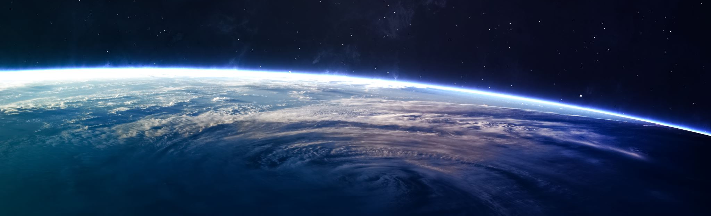
The Tychonic System
The Earth is at the center (or eccentric to the center) . The Sum moves around the Earth and the planets move around the Sun.
Observationally identical to the Copernican system (Sun and Earth are turned 180 degrees).
More than one center of motion.
Exercise in saving the appearances.

Slide 6
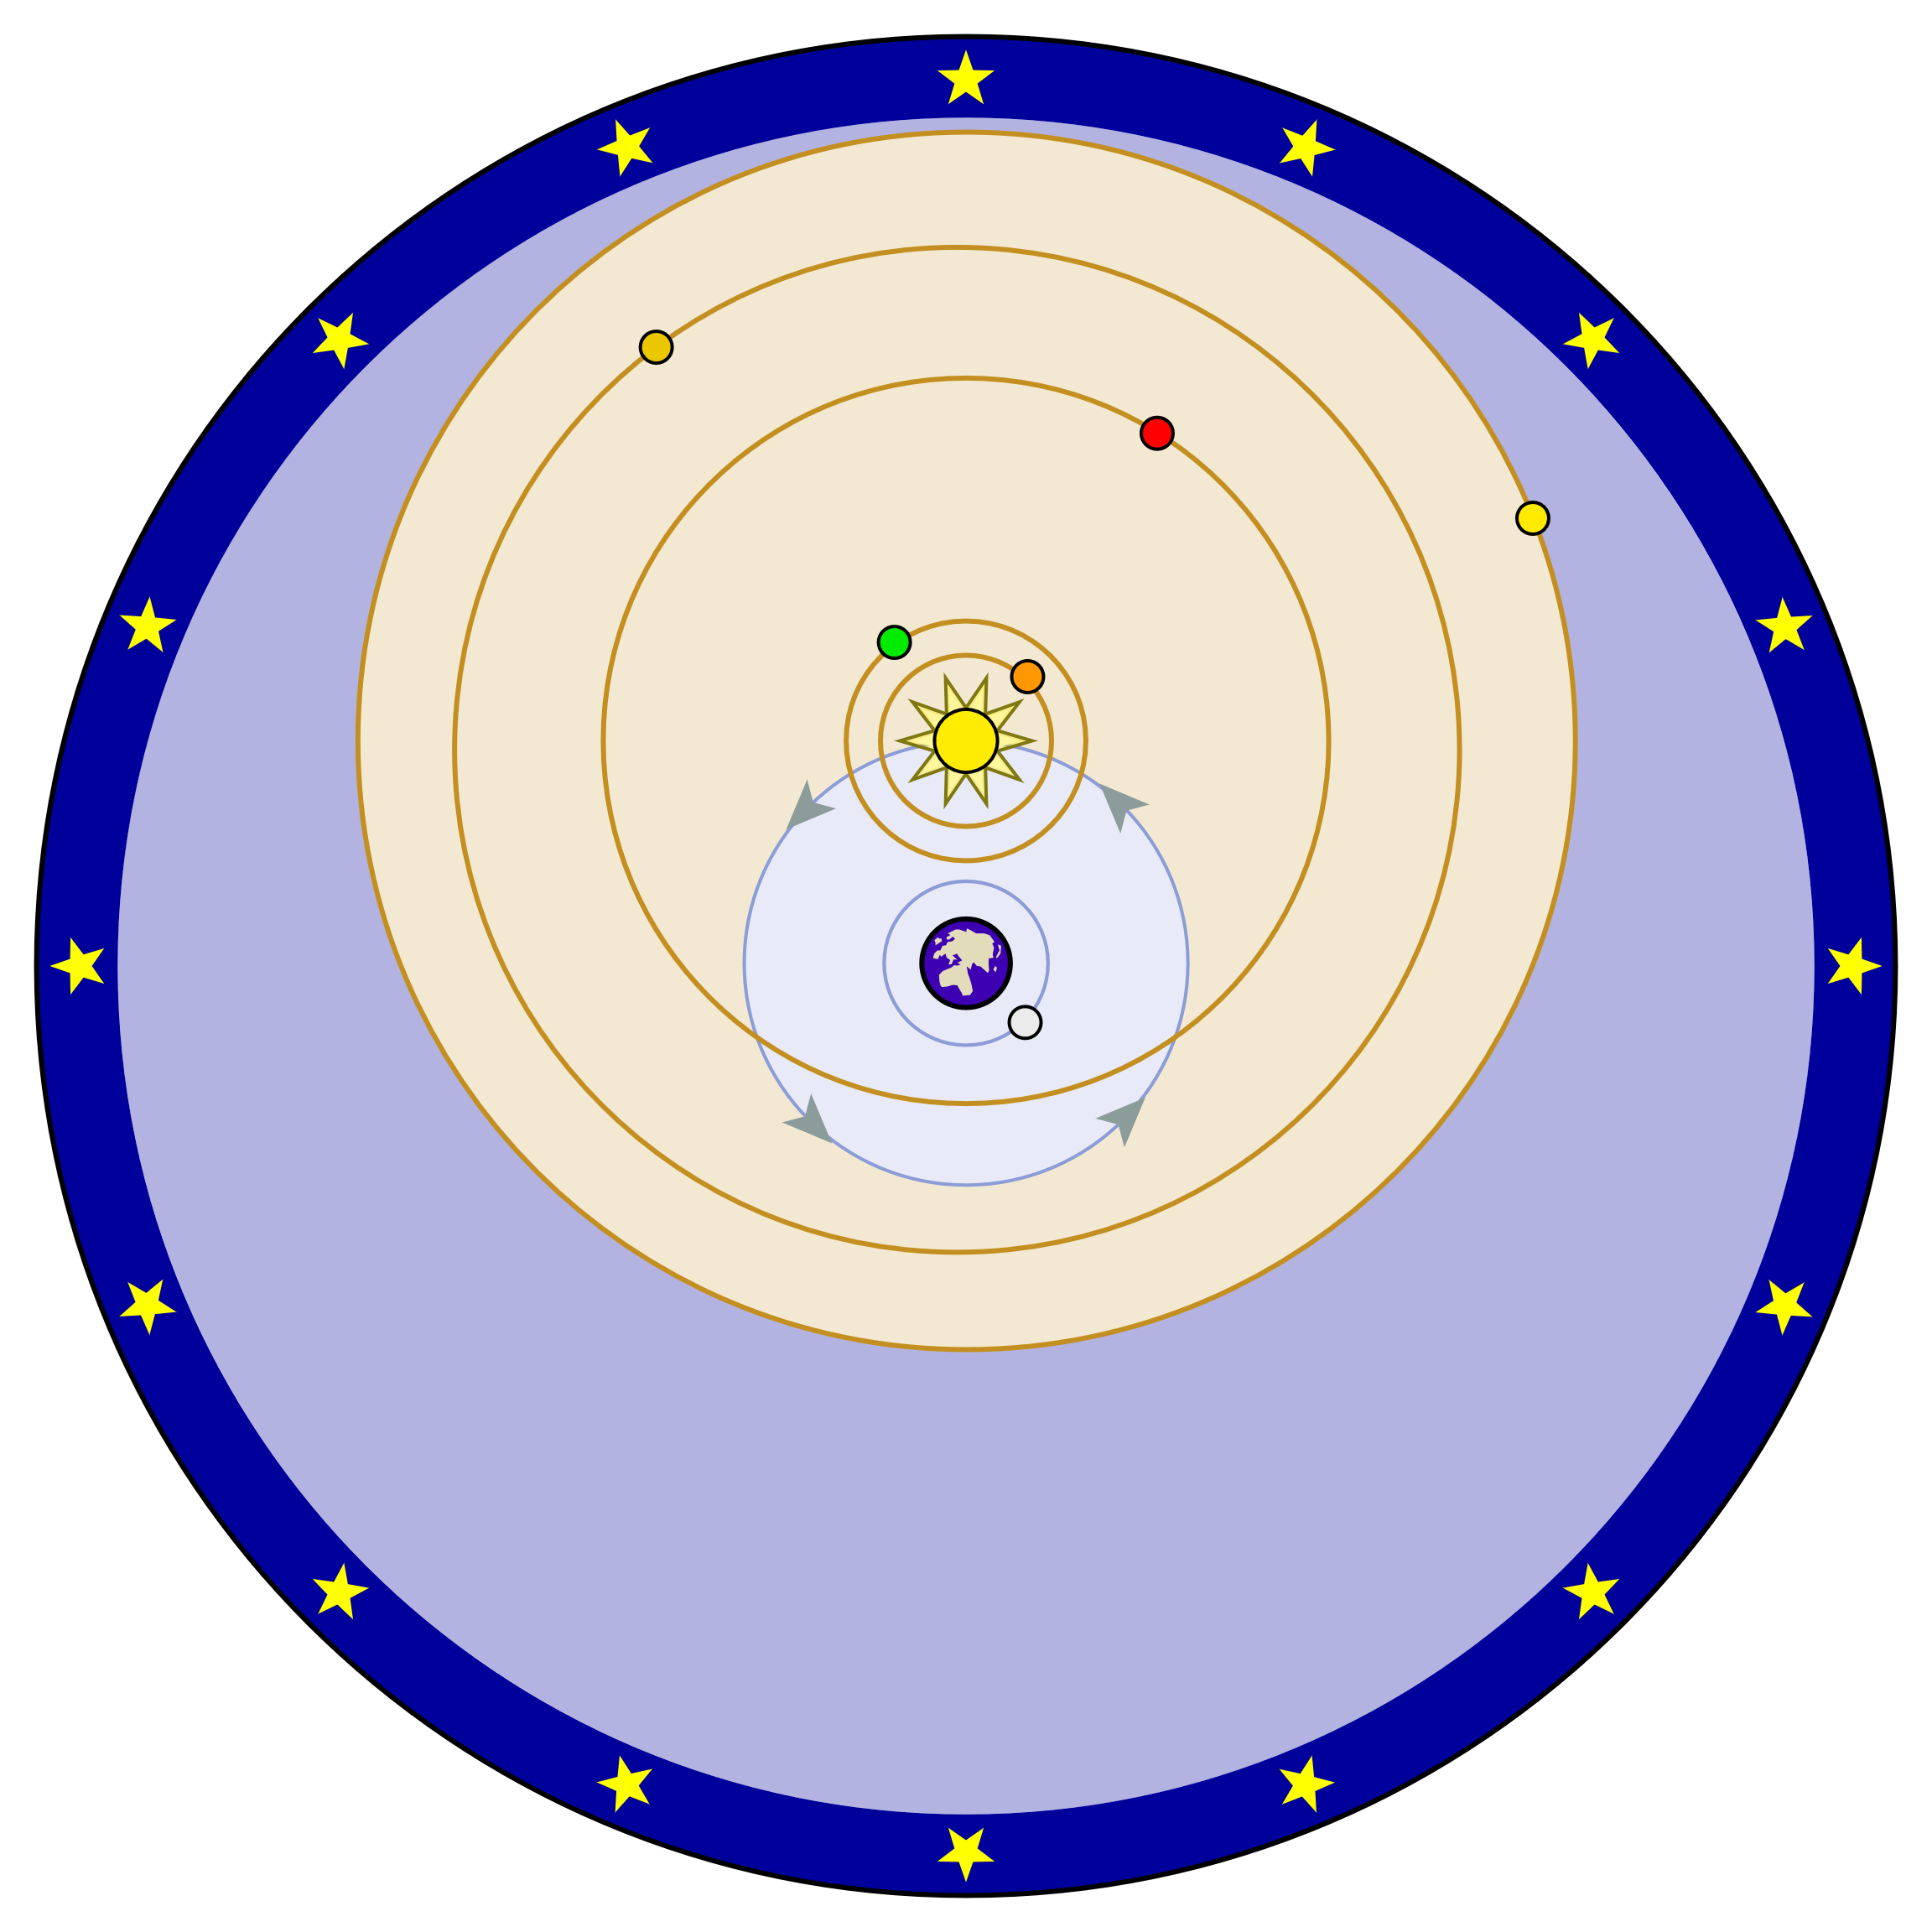
The Tychonic System

Slide 7
Phases of Venus
Galileo first observed phases of Venus in 1610 (but did not publish his observations until 1613). Galileo was able to observe Venus going through a full set of phases, a phenomenon that was impossible on the Ptolemaic system. (In order for Venus to be fully illuminated from the Earth, it would need to be on the far side of the Sun, which is impossible if Venus’ orbit is between the Earth and the Sun.

Slide 8
Brahe’s Greatest Discovery
As important as Brahe was to Renaissance astronomy, perhaps his most important discovery was Johannes Kepler, who accepted an invitation to work with Brahe in 1596.
Brahe had carried our discrete measurements of stellar bodies for more than 30 years, notably, Mars. Brahe died in 1601 and his collection of observations fell in Kepler’s hands.
While he was working with Brahe, Kepler was given two tasks: (1) find a way to reconcile the observations of Mars with Brahe’s model of the planetary system; (2) unpack a riddle concerning the camera obscura (which astronomers employed in their observations of the Sun. We will focus for the rest of the lecture on Kepler’s contributions to planetary astronomy and turn to issues concerning the camera obscura in a later lecture.

Slide 9
Kepler’s physical theory
“Astronomical problems are best resolved in terms of a mathem­atical analysis of their underlying physical causes.”
Kepler's brilliance is reflected in the way that he was able to extract a geometrically precise statement of the motions of the planets from the conceptual resources at his disposal (bits and pieces of Aristotelian physics, Copernicus' astronomical theory, and Gilbert's study of the magnet, etc.) that were not tailored for the purposes of physical astronomy.

Slide 10
Kepler’s Rules of Planetary Motion
It became apparent to Kepler in 1608-9 that the planetary orbits were not circles, and that no number of epicycles could account for the irregularities of their paths. Although at first unable to characterize these paths accurately, Kepler recognized that the planets accelerate as they approach the Sun, and slow down as they move away from it. In order to calculate the position of a planet at any time, he formulated two different laws.
The first states that the velocity of a planet varies with its distance from the Sun in such a way that a line joining the planet with the Sun sweeps out equal areas in equal times; and the second says that the velocity of a planet varies inversely as the distance from the Sun. The first is the form commonly known as Kepler’s second law of planetary motion, while the second is known as the inverse-distance law. Although Kepler initially regarded these laws as equivalent, by the end of the Astronomia nova he had corrected the distance law and recognized its incompatibility with the area law.

Slide 11
Kepler’s law of elliptical orbits
Kepler found that the only orbital shape that made sense of Brahe’s dats was the ellipse, and he conjectured that Mars (and the planets) move on ellipses around the Sun. An ellipse is kind of a stretched out circle. A real circle has the same width, or diameter, whether you measure it across or up and down. But an ellipse has diameters of different lengths. How long the longest diameter is compared to the shortest one determines the eccentricity (e) of the ellipse; it's a measure of how stretched out the ellipse is.
Circles have e=0 because their diameters are all the same. If an ellipse has one very short diameter, and one very long one, then it is a very stretched-out ellipse, and has an eccentricity nearly equal to 1.
Planets do move on ellipses, but they are nearly circular (e very close to 0). Comets are a good example of objects in our solar system that may have very elliptical orbits.

Slide 12
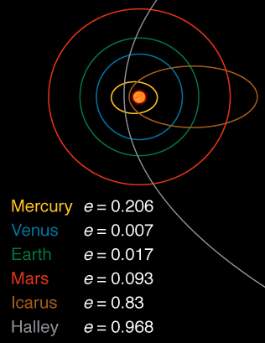
Eccentricities of orbits of the planets

Slide 13
Kepler realized that the line connecting the planet and the Sun sweeps out equal area in equal time. Look at the diagram to the left. What Kepler found is that it takes the same amount of time for the blue planet to go from A to B as it does to go from C to D. But the distance from C to D is much larger than that from A to B. It has to be so that the green regions have the same area. So the planet must be moving faster between C and D than it is between A and B. This means that when planets are near the Sun in their orbit, they move faster than when they are further away.

Slide 14
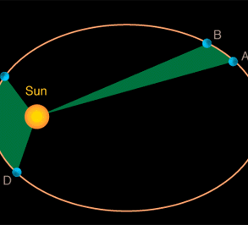
Kepler’s Second Law of Planetary Motion

Slide 15
Kepler and the Enchantment with Circular Motion
The ellipse law by itself has no observational consequences. Even if we have two orbital positions for a planet separated by a given time, we cannot calculate the area swept out in the same time. To do this, we would need the mathematical machinery of elliptical integrals, but this was not an option until 1750 or so.
Kepler attempted to use his elliptical law to calculate planetary positions along an ellipse in his Rudolphine Tables (1627), but his calculations were too difficult. Instead, he used the empty focus of the ellipse to make these calculations because the empty focus provided a uniform center of rotation.

Slide 16
Kepler and Newton
This solution gained a fair amount of currency in the seventeenth century, but it had no basis in physical theory. Moreover, these techniques signified a return to the deeply embedded ideal of uniform rotation, and certainly not the brave new astronomy proclaimed by Kepler's Astronomia nova. Even if one embraced Kepler's ellipse hypothesis as a likely candidate for the orbital shape, in the absence of the theoretical and mathematical tools that would put the area rule on the scientific map, the end result would be an astronomy that departed only negligibly from the astronomy of Ptolemy and Copernicus.
These considerations help to explain why the area rule is absent in the scientific liter­ature prior to Newton. Furthermore, since the area rule and the ellipse are tied together in Kepler's physical theory, there was no pressing reason for the astronomical community to treat Kepler's ellipse as more than a mere computational device.

Slide 17
Kepler’s Third Law of Planetary Motion
Kepler's 3rd Law: P² = a³
Kepler's 3rd law is a mathematical formula. It means that if you know how long it takes a planet to go around the Sun (P), then you can determine that planet's distance from the Sun (a).
This formula also tells us that planets far away from the Sun take longer to go around the Sun than those that are close to the Sun.

Slide 18
The Elements of Kepler’s Physical Theory
The Sun rotates on its own axis, carrying an image (species immateriata) of its body through the entire extent of the universe.
This image was held by Kepler to have the power to overcome the resistance of the planet to motion (the planet’s inertia) and carry it in its grasp.
As justification for this solar force, Kepler drew on William Gilbert's De Magnete (On the Magnet, 1600). Just as the Earth has the capacity to direct a magnetic needle north and south, Kepler held that the Sun (which is a spherical body as well) directs the motion of the planet.
A new style of reasoning: analogy.
For Kepler, the solar virtue is not a magnetic force as such. There is no true coition or coming together of the Sun and the planet in the manner specified by Gilbert for two magnetic bodies and the Sun is held, rather, to move the planet by the motion of its filaments. Kepler therefore conceived the solar virtue as a quasi-magnetic action that causes the planet to orbit the Sun.

Slide 19
Kepler and the Concept of Inertia
This suggestion implies that the planets have the same period of revolution, conforming to the Sun's rotation on its axis. In order to reconcile the different periods of the planets with his magnetic theory, Kepler submitted that the planets are inclined, because of matter, to remain in their place.
The introduction of the concept of inertia proved to be a remarkable event in the history of science, but Kepler conceived a body’s inertia as a resistance to motion and not, in the manner that we now associate with Galileo, as a state of rest or motion. Inertia, for Kepler, occasions a resistance to motion on the part of the planets. A planet's velocity, conse­quently, is determined by the strength of the solar force acting on the planet, relative to this resistance. More massive planets, Kepler contended, move more slowly on account of their greater inertia or resistance to motion.

Slide 20
Kepler and Circularity
The explanation for Kepler's conflation of magnetic attraction with gravitational attraction is complex but at least two points are pertinent.
The first was the enchantment with circularity, which was his birthright as a Renaissance astronomer.
The second was his goal of providing a physical basis for the Copernican theory. It appeared as though Gilbert's magnetic theory could be made to serve both ends, and Kepler clearly was less than rigorous in assessing its suitability for his new astronomy. The consequence of Kepler's enthusiasm for Gilbert's work is that the per­fect­ly simple planetary path projected by the Copernican system emerges, in his planetary theory, as an idealized model of planetary motion under the sole influence of the circum­solar force.

